Slide 1
Networking and troubleshooting
made by daksh kumar sharma
During internship at bsnl jaipur

Slide 2
outlines
Objective
About company
Abstract
Software used
Hardware used
advantages
Disadvantages
Snapshot
Conclusion

Slide 3
objective
The objective of this project Is to design a simulated network models and troubleshoot problem related to networks using cisco packet tracer.
Learnt about gsm,cdma,wimax,optical fibre communication broadband & bus

Slide 4

About company
BSNL(Bhartiya sanchar nigam limited) is one of the world’s 7 largest telecom company
BSNL is a public sector unit
It provides internet & communication services
It provides system hardware to other telecommunication company

Slide 5
Abstract
In today’s world communication and networking has became a need instead of luxury
I did my industrial training at BSNL and learnt about how to design simulated networks using cisco packet tracer
I have designed many simulated networks during my industrial training

Slide 6

Software used
Cisco packet tracer

Slide 7
Hardware
Switches
Hub
Router
cables

Slide 8
advantages
Easy to use & understand
Unambiguous
Lower system requirement

Slide 9
disadvantages
Can not identify real world problem so troubleshooting takes place

Slide 10
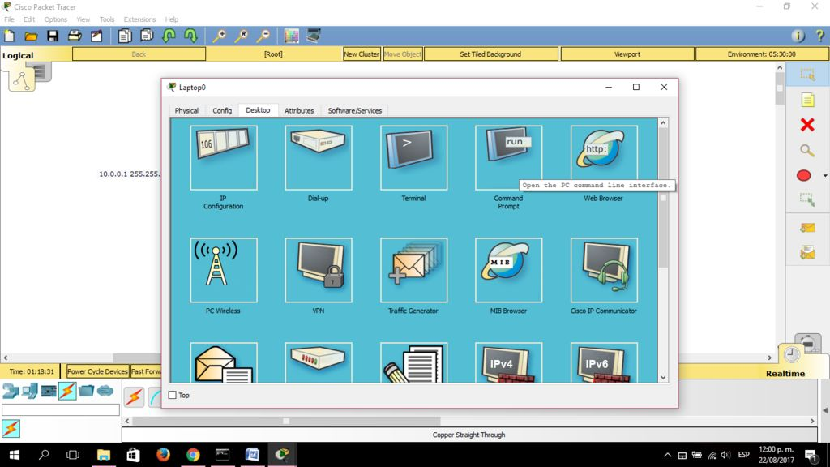
Snap shots

Slide 11
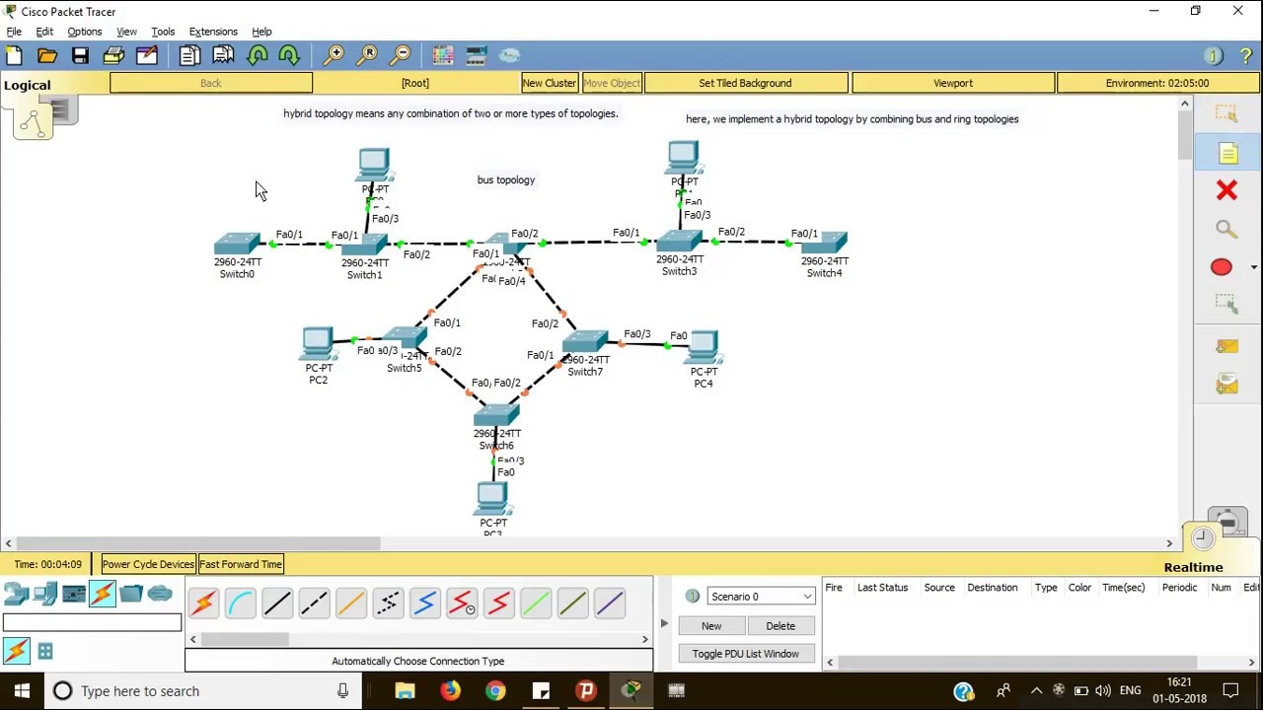

Slide 12
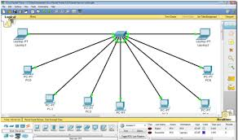

Slide 13
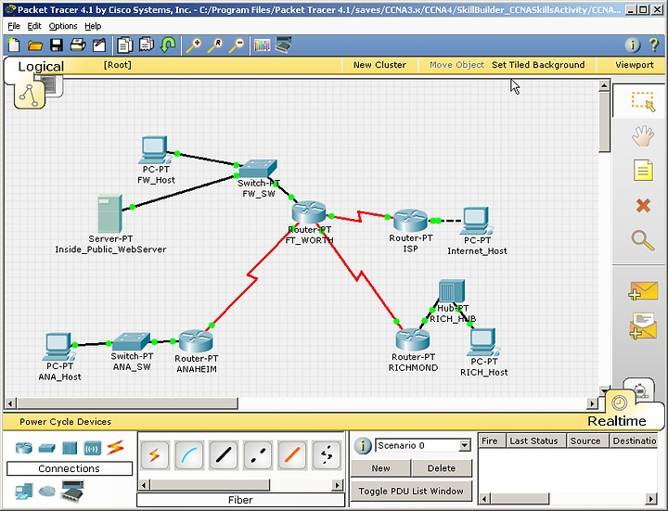

Slide 14
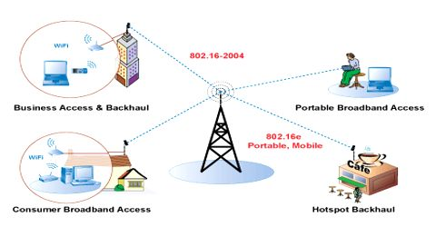
wimax
Worldwide Interoperability for Microwave Access
Is a certification mark for products that pass conformity and interoperability tests for the IEEE 802.16
provides wireless data over long distances in a variety of ways, from point-to-point links to full mobile cellular type access

Slide 15
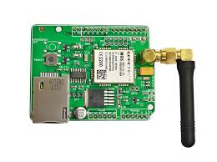
Gsm
SERVICE CATEGORIES
Main type of telecommunication services: Basic services: Available to all subscribers to a mobile network. e.g. voice telephone calls. Supplementary services: Additional services that are available by subscription only. e.g. Call forwarding.

Slide 16
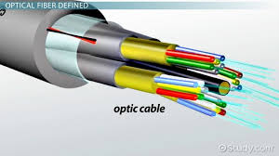
FIBER OPTICAL TRANSMISSION SYSTEM
A Widely Used Communication Medium Based on TIR Information (Voice, Data Or Video) Is Transmitted In The Form Of Light

Slide 17
conclusion
My project has been developed for the given condition and is found working effectively.

Slide 18
Thank you

